Slide 1
HOW TO DISAGREE
PROJECT OF MARCO LASSANDRO

Slide 2
GOALS OF THE PROJECT
CREATION OF A DATASET BASED ON THE PAUL GRAHAM HIERARCHY;
CREATION OF NEURAL NETWORK MODELS ABLE TO CLASSIFY APPROPRIATLY THE LEVEL OF DISAGREEMENT OVER PAIRED STATEMENTS
EVALUATION OF THE MODELS OVER THE GIVEN CLASSIFICATION TASK

Slide 3
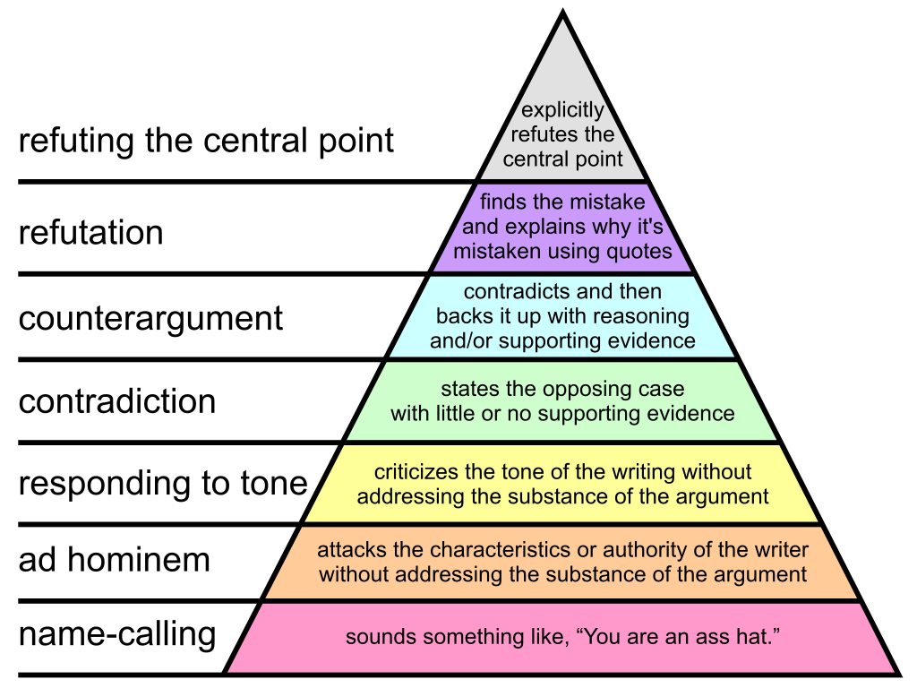
PAUL GRAHAM HIERARCHY

Slide 4
THE DATASET
It is a collection of 950 examples labeled according to a variant of the Paul Graham hierarchy;
It has been stored as a csv file, here below an explanation of the fields:
statement 1: the first statement refers to a given topic;
statement 2: the second statement is the disagreement given to the first statement;
label: the label is an integer, in a range from 1 to 4, that represents a category of the disagreement;

Slide 5
VARIANT OF THE PAUL GRAHAM HIERARCHY
1° category: all the disagreements that are not related to the content of what has been stated before, but rather on the person;
2° category: all the disagreements that state just the opposite of what has been stated before;
3° category: all the disagreements that state the opposite and make a reasoning by adding some evidences on their side.
4° category: all the disagreements that make refutations of what has been stated before, generally the refutation is done by quoting some passages of the previous statement and explaining why it’s mistaken.

Slide 6
CONSTRUCTION OF THE DATASET
Three different dataset has been used in order to build the final dataset:
Agreement by Create Debaters (ABCD);
Hate Speech and Offensive Language Dataset;
Contradiction dataset;
How they have been used:
1° category: in this case the first statements of the pairs have been retrieved from the ACBD dataset, meanwhile the second statement of the pairs have been retrieved from the ”Hate Speech and Offensive Language Dataset”. This has been done in order to simulate the name-calling/adhominem disagreement level.
2° category: for the second category the pairs have been retrieved from the ”Contradiction dataset”;
3° and 4° category: for the last two categories just the ACBD dataset has been used;

Slide 7
EXPERIMENTAL SETUP
PRE-PROCESSING STEPS APPLIED OVER THE TEXT:
Lower casing;
Removal of punctuations;
Removal of stopwords;
Removal HTLM tags;
Expansions of verbal contractions;
VECTORIZATION OF THE STATEMENTS:
From text features to integer sequences;
Length of the sequences fidex to 200;
Application of zero-padding;
WORD EMBEDDING:
In order to embed the word of the statements a pre-trained model of GloVe has been used;
The pre-trained model is the one with 300 dimensions trained on Common Crawl with 840 billion tokens.

Slide 8
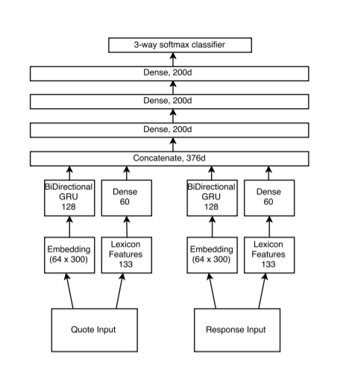
MACHINE LEARNING MODELS
The architectures for the two models used in the experiments have been inspired from the article “Agree to Disagree: Improving Disagreement Detection with Dual GRUs”:
Goal of their research was the detection of (dis)agreements by performing a 3-way classification (agreement/disagreement/none) over Q-R pairs;
GloVe word embeddings are fed to Gated Recurrent Unite to create a sentence embedding;
From each text a lexical feature vector is extracted by using sentiment, emotion, opinion lexicons;

Slide 9
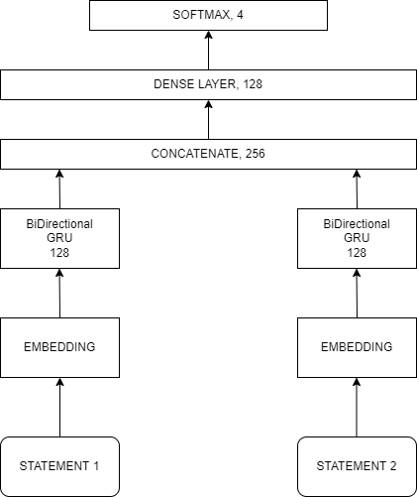
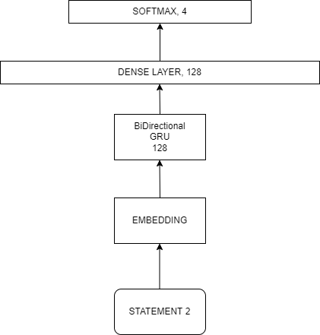
MACHINE LEARNING MODELS
The main architecture used in the experiment is a simplification of the previous archictecture:
the number of fully connected layers have been reduced to 1;
The lexical feature has been removed;
The units of the softmax layer have been passed to 4 since we have 4 categories of disagreements;
Another architecture has been used in order to understand how much impact has the first statement over the classification task:
In this case there is no presence of a second GRU branch, so as input we have just the second statement, that is the one related to the disagreement;

Slide 10
MACHINE LEARNING MODELS
SYSTEM PARAMETERS:
The fully connected layers have a ReLU activation;
The neural networks are optimized with Nadam optimizer with learning rate of 0.001 and the loss function used was the ”categorical crossentropy”;
FOR THE EVALUATION:
A stratified K-fold cross validation technique has been used;
K has been fixed to 10;
for each model 20 epochs have been performed on the optimization phase of the network;

Slide 11
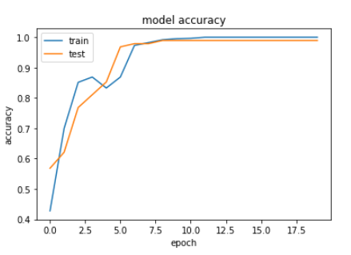
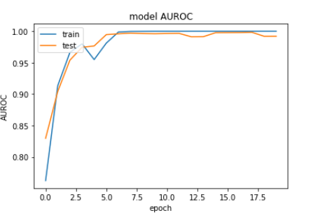
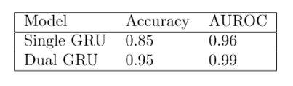
MACHINE LEARNING MODELS RESULTS

Slide 12

CONCLUSIONS AND FUTURE WORKS

